Slide 1
Push better software with Pull Requests
Rob Moore
Lead Consultant, Readify
rob.moore@readify.net @robdmoore
Notes:
Using pull requests over the last couple of years across a range of open source projects (both personal and part of TestStack) and all of the commercial projects I work on.

Slide 2
What even is a Pull Request anyway?
Notes:
Developers who are familiar with open source will likely be aware of pull requests, which were created and popularised by GitHub as a way of providing some automation, visibility and social interaction around merging software changes. It replaces the old school notion of emailing patch files to each other.

Slide 3
Pull Request
Github.com/Org/Repo
Github.com/Rob/Repo
Fork!
Clone
Local Repository
Notes:
As a contributor, I do not have write access to the main repo
So I create my own fork which I can write to.
Pull Requests are simple a request to get your code pulled into the main repository which you do not have access to (in the open source model).

Slide 4
Pull Request
Github.com/Org/Repo
Github.com/Rob/Repo
Fork!
Pull Request
Push changes into Fork
Local Repository
Notes:
It’s worth noting that pull requests work well for mainline development and continuous delivery and if that’s something you are interested in discussion then come chat to me later.

Slide 5
Let’s see a Pull Request in action!
Notes:
https://github.com/MRCollective/ChameleonForms/pull/87

Slide 6
Pull Requests: the bedrock of modern OSS development

Slide 7
Contributors
Random third parties
Easy and effective
Contextual conversations
Keep track of core team

Slide 8
Maintainers
Easier/more contributions
Contextual conversations
Get code ready to merge
Fosters collaborative community
Review all code

Slide 9
Coordinate distributed WIP
master
featurex
rob/featurex
matt/featurex
Make Branch
Open Pull Request
Branch
*Commit*
*Commit*
Open Pull Request
Branch
*Commit*
Open Pull Request
Merge once OK

Slide 10
Lowers barrier of entry for everyone

Slide 11
Pull Requests and commercial software: strange acquaintances or comfy bedfellows?

Slide 12
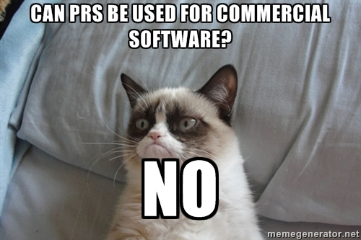
What’s the point?
We don’t need PRs right?
We have:
Closed source
Everyone with access to the repo
We are collocated
We have existing code review processes

Slide 13
Increase quality through code reviews
Notes:
Code reviews actually happen
Consistency, maintenance and quality reviewed
Contextual conversations

Slide 14
Increase quality by reducing technical debt
Notes:
Inertia isn’t an excuse anymore

Slide 15
Increase quality by reducing build failures
Notes:
Build integration

Slide 16
Support new developers
Upskill juniors
Notes:
Low barrier of entry to learning about codebase
Confidence to raise risk-free PRs
Contextual conversations
Learning founded in practical application
Smaller ramp up
Level playing field
Easy for junior devs to learn and upskill

Slide 17
Remote work / context switching
Notes:
Asynchronous
Timezone friendly code reviews
Contextual conversations

Slide 18
Easily separate changes
git checkout –b featurew
git commit –am “Added feature X”
git commit –am “Refactored y”
*Find bug*
git checkout master
git checkout –b bugz
git commit –am “Fixing bug”
git push origin bugz
*Create Pull Request*
git checkout featurew
*Continue work*

Slide 19
Reduce feedback cycles
Notes:
Work in progress can be submitted for contextual conversation early
Technical spikes can be developed in the open
https://github.com/TestStack/TestStack.BDDfy/pull/89 is a good example of a long running PR with people collaborating

Slide 20
Use OSS model to scale
Product A
Codebase
Product B
Codebase
Product A Core Team
Pull Request
Product B Core Team
Notes:
Core team – maintain standards, consistency and vision
Rest of organisation submits changes via pull requests

Slide 21
The most effective change I’ve introduced that has improved code quality!

Slide 22
It can’t be a silver bullet right? … right?

Slide 23
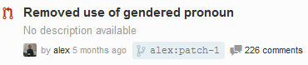
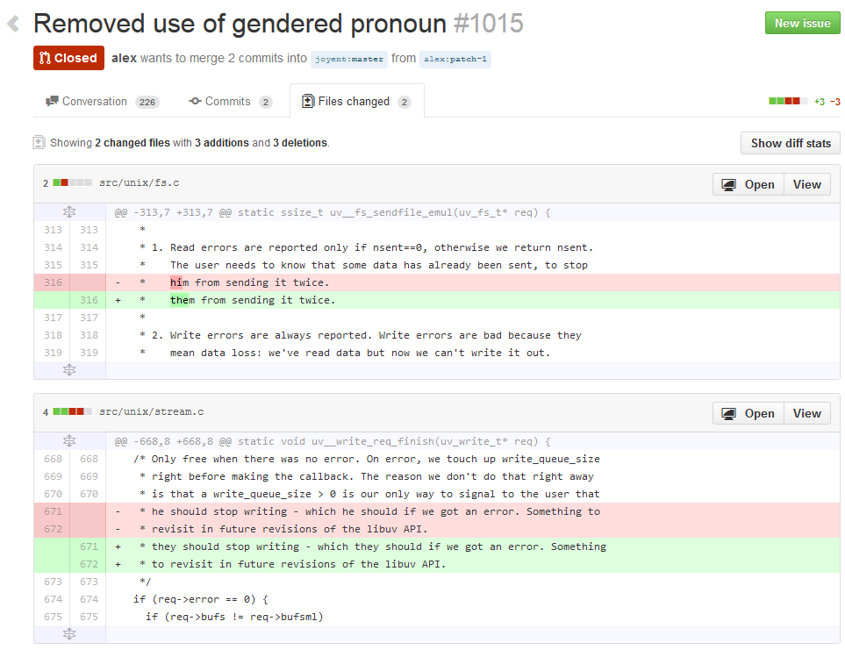
Bikeshedding
Notes:
https://github.com/joyent/libuv/pull/1015
http://en.wikipedia.org/wiki/Parkinson%27s_law_of_triviality

Slide 24
“Just because you are capable of building a bikeshed does not mean you should stop others from building one just because you do not like the color they plan to paint it … you need not argue about every little feature just because you know enough to do so … the amount of noise generated by a change is inversely proportional to the complexity of the change.”
Poul-Henning Kamp, 1999
Notes:
http://bikeshed.com/
FreeBSD

Slide 25
Balancing pickiness
Particularly picky people might be avoided
Minor changes stop important work getting merged

Slide 26
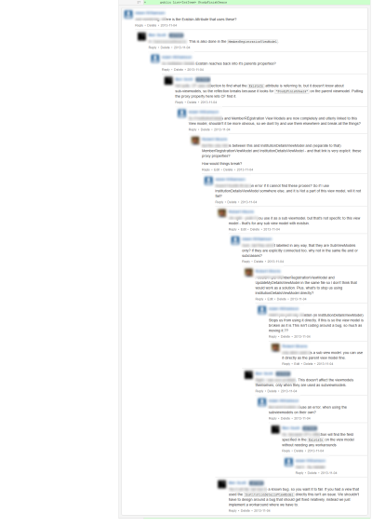
Less efficient communication
Notes:
After the problem is resolved then comment back on the PR so anyone else following the conversation can see the resolution.

Slide 27
Lack of respect
smelly
code smell
bad practice
awful
rubbish
irresponsible
why would you do that?

Slide 28
Lack of cohesion
No core team
Lot’s of conflicts
PRs might get merged with little inspection
Devs might merge their own PRs
Competing priorities: ignoring review comments

Slide 29
Big PRs
Longer to get up
Harder to review
More likely to be wrong
Harder to integrate

Slide 30
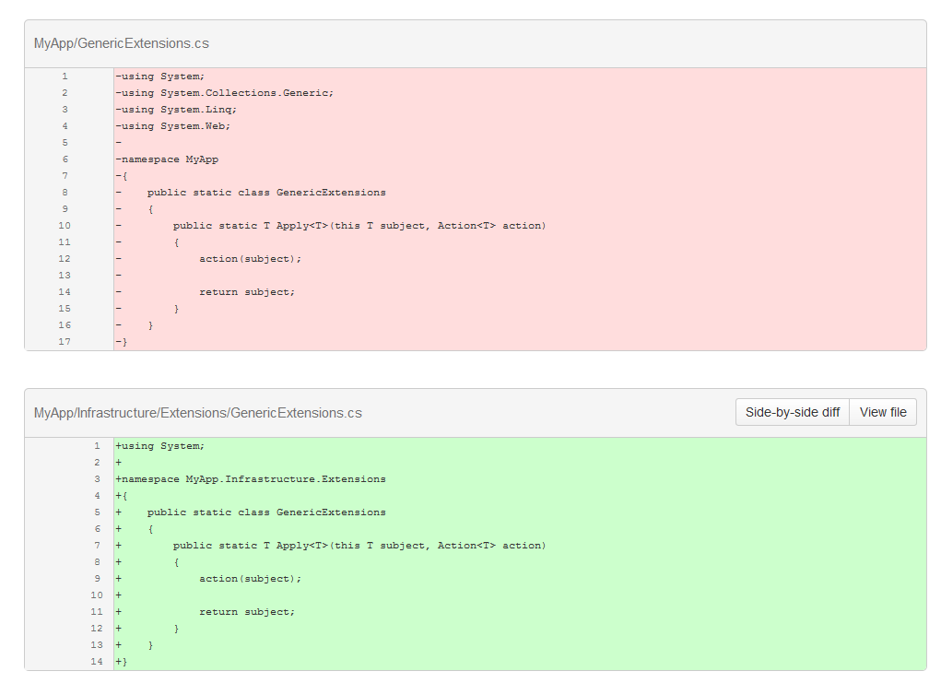
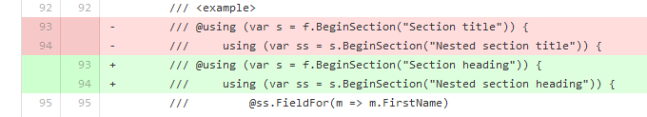
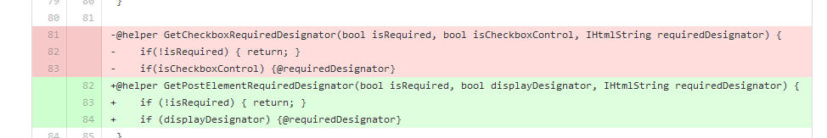
Bad diff UIs

Slide 31
There are things to be wary of, but in general they can be dealt with and PRs often help visualise them

Slide 32
You’ve got me convinced – what tips do you have?

Slide 33
Invest in the future
Commit hygiene
Retain metadata when merging
Keep PRs focussed
Good branch/PR name and PR description

Slide 34
PR Hygeine
Small
Frequent
Delete remote branches when merged

Slide 35
Collaborate mindfully
Subscribe to notifications
Regularly review and merge PRs
Prefer one PR per person
Integrate early or via separate PR

Slide 36
Act as a team
Be nice
Avoid emotive phrases
Call out awesome work
Ask questions when you aren’t sure
Don’t interrupt people if your PR isn’t urgent
Discuss major work before raising a PR

Slide 37
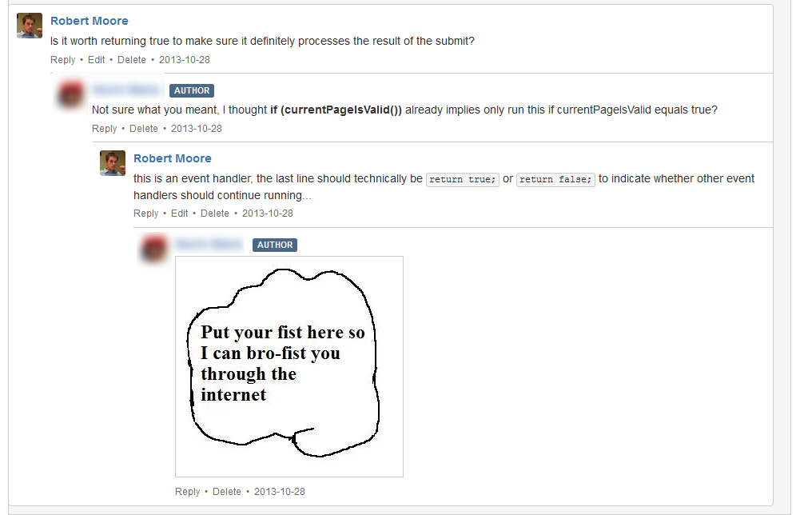
Have fun!

Slide 38
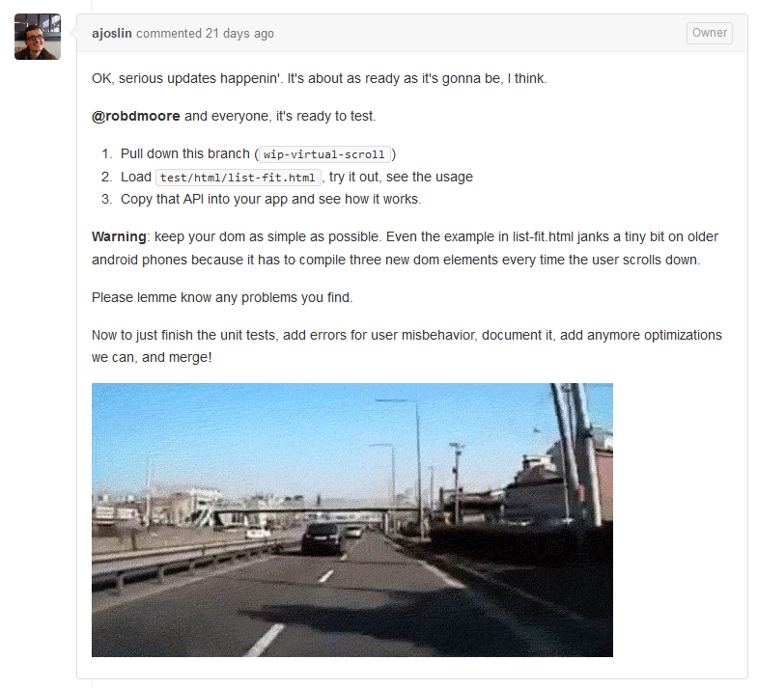


Slide 39
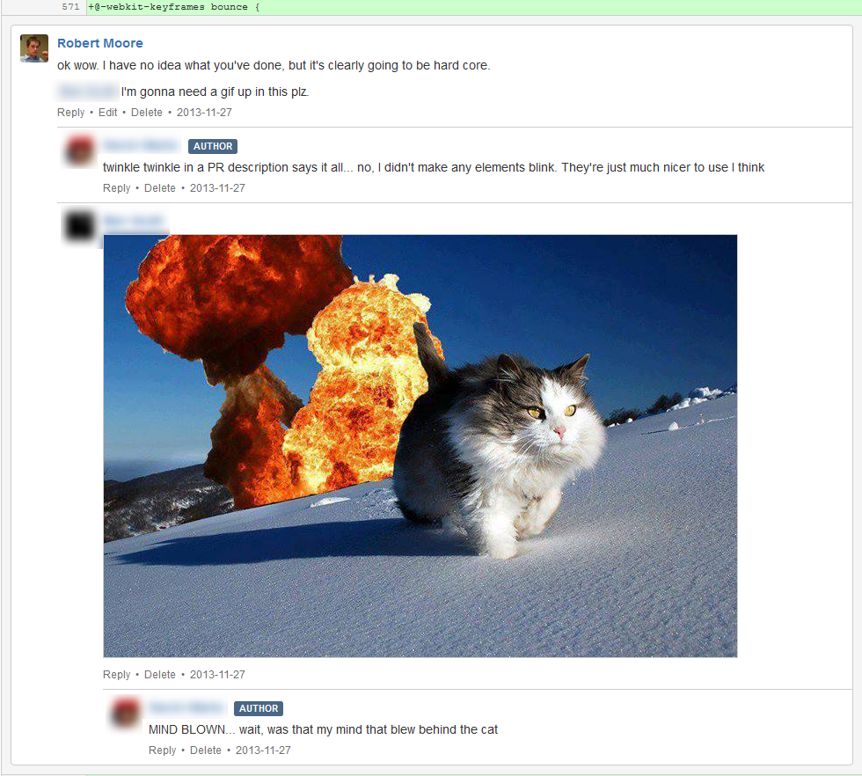

Slide 40
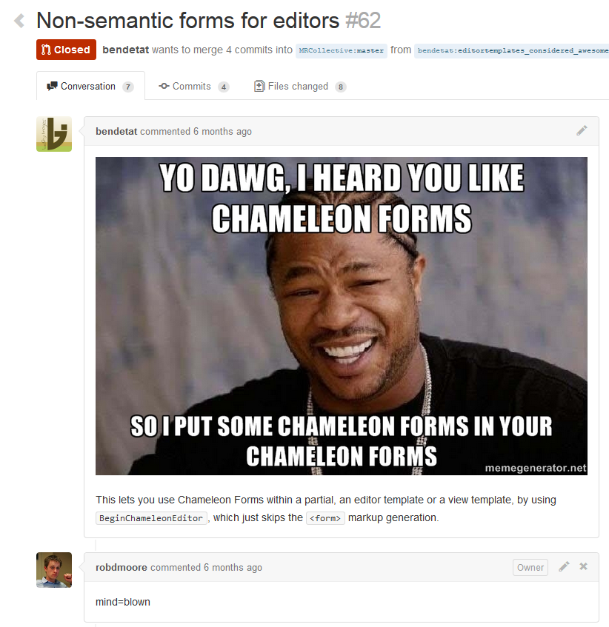

Slide 41
These tips will help make PRs work smoothly

Slide 42
So what should I do when I go back to work on Thursday?

Slide 43
Getting started
Use Git ☺
Find someone that knows Git well
In the first couple of weeks have someone push hard to regularly review and merge PRs to get the team in a flow then after that let the team self organise into their own rhythm from there
When there is inevitably pain from large PRs let it happen and then after the fact be retrospective

Slide 44
Tools
Build notifications – Stash and GitHub
GitVersion – detect pull requests and version appropriately
GitHub
GitHub Enterprise
Bitbucket
Stash
GitLab

Slide 45
Be respectful Have fun Keep PRs small
Notes:
If you have only 3 takeaways apart from the fact you should be using pull requests then they would be…

Slide 46
Questions?
Rob Moore Lead Consultant, Readify rob.moore@readify.net @robdmoore
Notes:
Mention mainline development and CD

Slide 47
Further Reading
http://robdmoore.id.au/blog/2013/12/01/using-pull-requests-for-commercialprivateproprietary-development/
https://help.github.com/articles/using-pull-requests
https://confluence.atlassian.com/display/BITBUCKET/Work+with+pull+requests
https://confluence.atlassian.com/display/STASH/Using+pull+requests+in+Stash
http://scottchacon.com/2011/08/31/github-flow.html
https://github.com/blog/1124-how-we-use-pull-requests-to-build-github
http://blog.codeship.io/2013/08/22/the-codeship-workflow-part-2-pull-requests-and-code-review.html
http://cesiumjs.org/2013/10/08/GitHub-Pull-Request-Workflows/

Slide 48
Pull Requests and Mainline Development and Continuous Delivery oh my!?

Slide 49
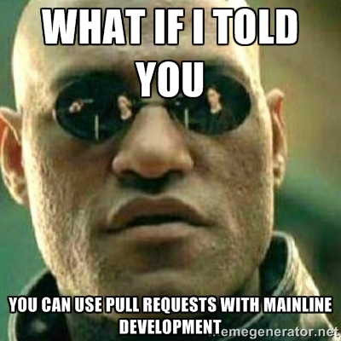
PRs and mainline development
Notes:
http://memegenerator.net/instance/49607796
Feature toggles = smaller PRs ☺

Slide 50
“PRs should represent a ‘set of changes you want to merge into master’ rather than ‘a complete feature ready to be integrated’. As such they are directly compatible with mainline development.”
Rob Moore, 2014

Slide 51
PR as a CD pipeline step
PRs increase confidence
Build PRs to get even more confidence
Ensure reviewers are thinking about effect on prod

